Slide 1
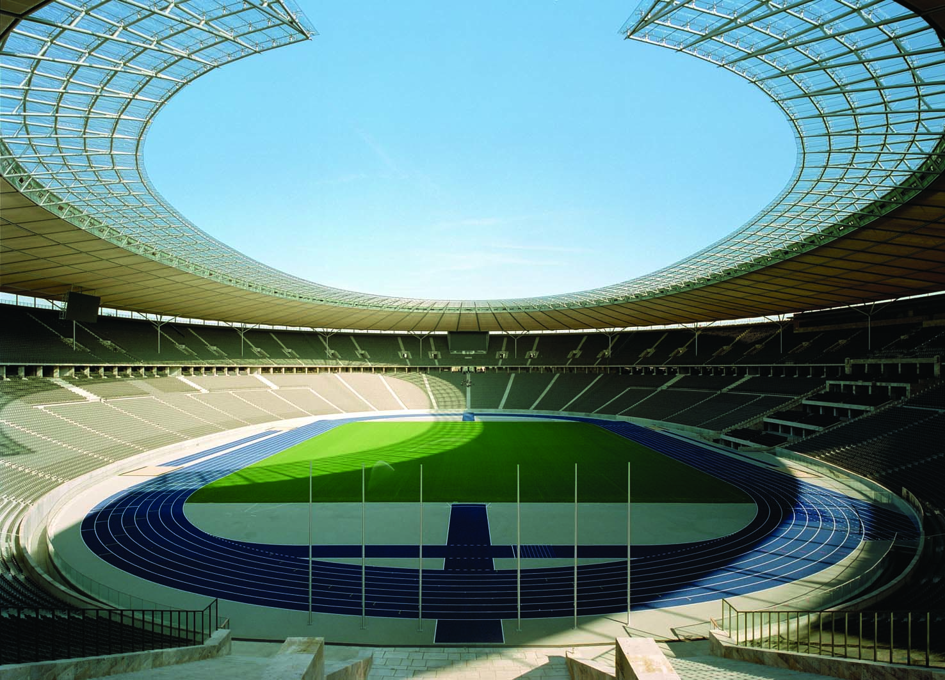
11
THE MACROECONOMICS OF OPEN ECONOMIES

Slide 2
31
Open-Economy Macroeconomics: Basic Concepts

Slide 3

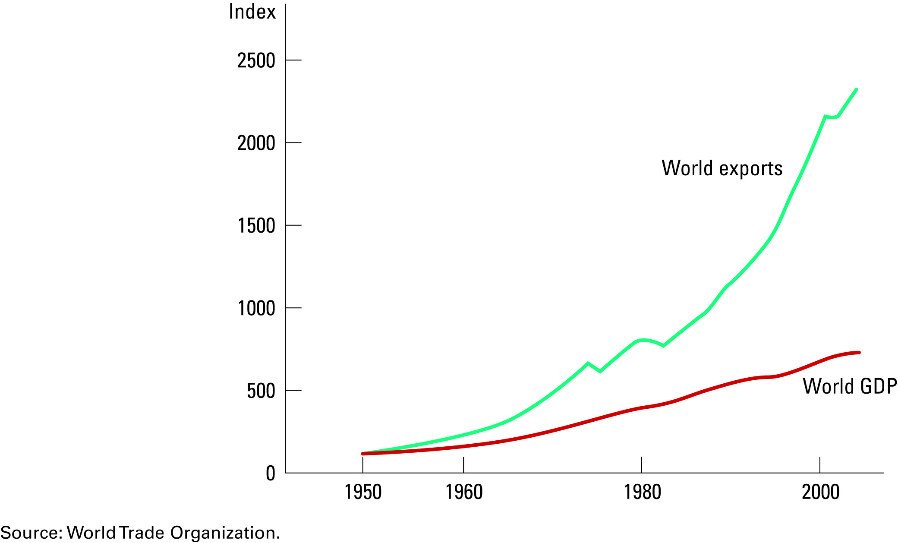
Figure 1 The Increasing Openness of the World Economy
Copyright © 2004 South-Western

Slide 4
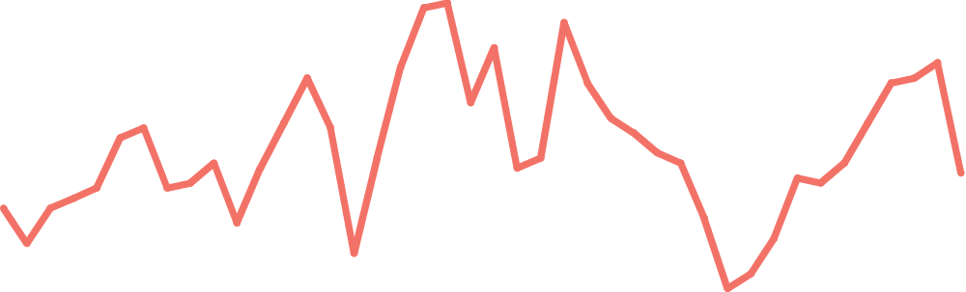
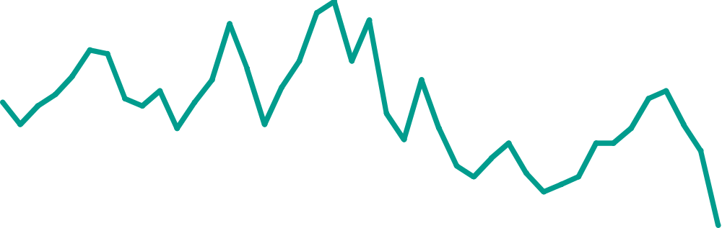
Figure 2 US National Saving, Domestic Investment, and Net Foreign Investment
(a) National Saving and Domestic Investment (as a percentage of GDP)
Percent
of GDP
20
Domestic investment
18
16
14
12
National saving
10
1960
1965
1970
1975
1980
1985
1990
1995
2000
Copyright © 2004 South-Western

Slide 5
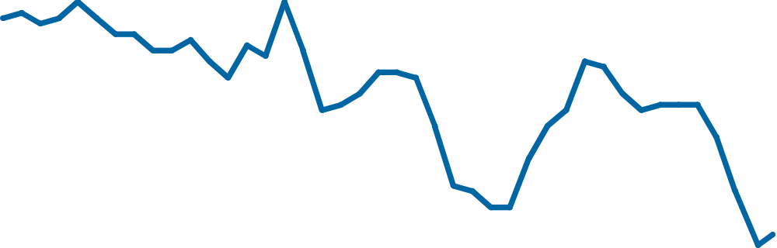
Figure 2 US National Saving, Domestic Investment, and Net Foreign Investment
(b) Net Capital Outflow (as a percentage of GDP)
Percent
of GDP
4
3
2
Net capital
1
outflow
0
–1
–2
–3
–4
1960
1965
1970
1975
1980
1985
1990
1995
2000
Copyright © 2004 South-Western

Slide 6
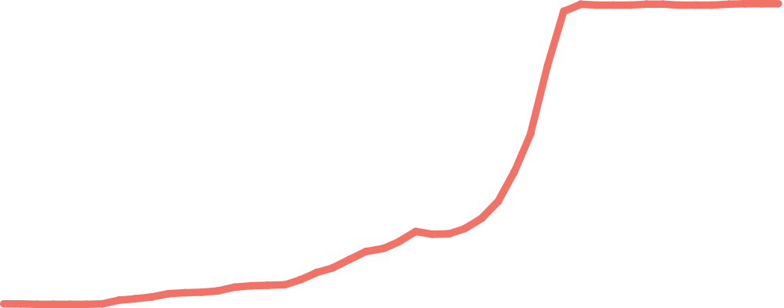
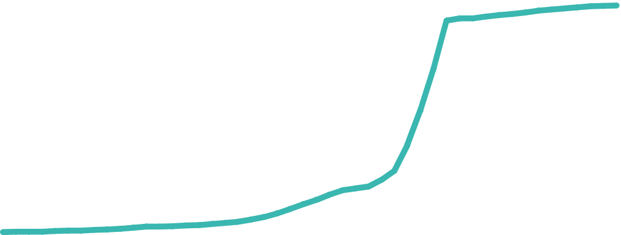
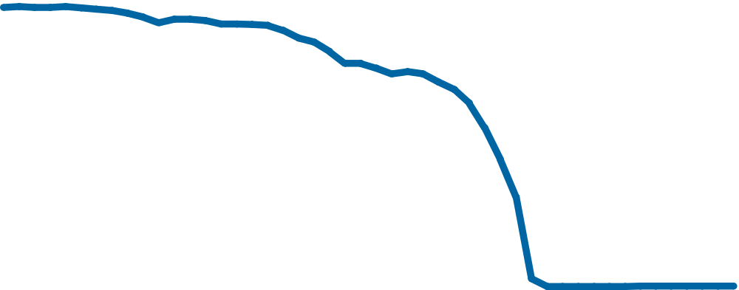
Figure 3 Money, Prices, and the Nominal Exchange Rate During the German Hyperinflation
Indexes
(Jan. 1921
=
100)
1,000,000,000,000,000
10,000,000,000
Money supply
Price level
100,000
1
.00001
Exchange rate
.0000000001
1921
1922
1923
1924
1925
Copyright © 2004 South-Western

